Slide 1
Engineering Issue Reporting - JIRA
Operations Support

Slide 2
Support Operations Team
The Product & Engineering team shall be supporting Operations team in a new platform - Jira Service Management.
Issues shall be submitted via
Integration with Zendesk
Email: engineering@kokonetworks.com

Slide 3

Table of Content
Operation Level Agreement
Tickets from Zendesk

Slide 4
Operational Level Agreement Summary
Support hours - Mon thru Friday 8:00AM to 6:00PM EAT
Response time - time taken to respond to ticket/issue submitted
Resolution time - time taken to resolve issue or provide a way forward once the ticket has been assigned to the Investigator

Slide 5
OLA: Priority Levels
Priority | Impact | ‘Colloquial’ definition | Response time | Resolution time | Definition
P0 | Critical | Potentially catastrophic event with massive business impact. ‘All hands on deck’ | 15 min | 2 hours | >60% of customers unable to buy fuel safely AND/OR >60% of KPs unusable AND/OR Systems failure affecting all customers or agents
P1 | Critical | Major event with significant business impact. Full attention and focus. | 30 min | 4 hours | >10% of customers unable to buy fuel safely AND/OR >10% of KPs unusable AND/OR Partial systems failure affecting >50% of our customers or agents with only partial availability of our services (e.g. wallet top-ups not working)
P2 | Major | Event with measurable business impact | 1 hour | 1 business day | Several customers unable to buy fuel (but <10% of total customers) AND/OR >5 KPs unusable (but <10%) AND/OR Partial systems failure affecting <50% of our customers or agents with only partial availability of our services (e.g. wallet top-ups not working)
P3 | Minor | Event with only minor business impact | 2 hours | 3 business days | 1 to 5 KPs unusable AND/OR Partial systems failure affecting <10% of our customers or agents with only partial availability of our services (e.g. wallet top-ups not working) AND/OR Anything else

Slide 6
OLA: Impact Definition
Impact | Definition
Critical | Large parts of our service are down or unavailable AND / OR Business is at major risk of revenue loss, reputation, health & safety, legal
Major | A smaller subset of our service is unavailable to customers/agents Customers are dissatisfied Business risk is imminent (revenue loss or reputation)
Minor | No major customer impact Service availability or safety may be at risk without prompt attention Business operations are functional but degraded

Slide 7
Ticket Requirements
To better address tickets please provide as much information as possible e.g.
What happened? please describe in detail what the issue is and include preceding actions if possible
Which system (component) was the issue observed on? STS, KP, KOKOCore etc
Who experienced the issue? Customer, NOC, STS Operator, CC etc
What is the impact of the issue to customer/NOC team/other stakeholders?
What workaround if any is being used?
NB: This is for all tickets raised via the help desk or email

Slide 8
Tickets from Zendesk

Slide 9
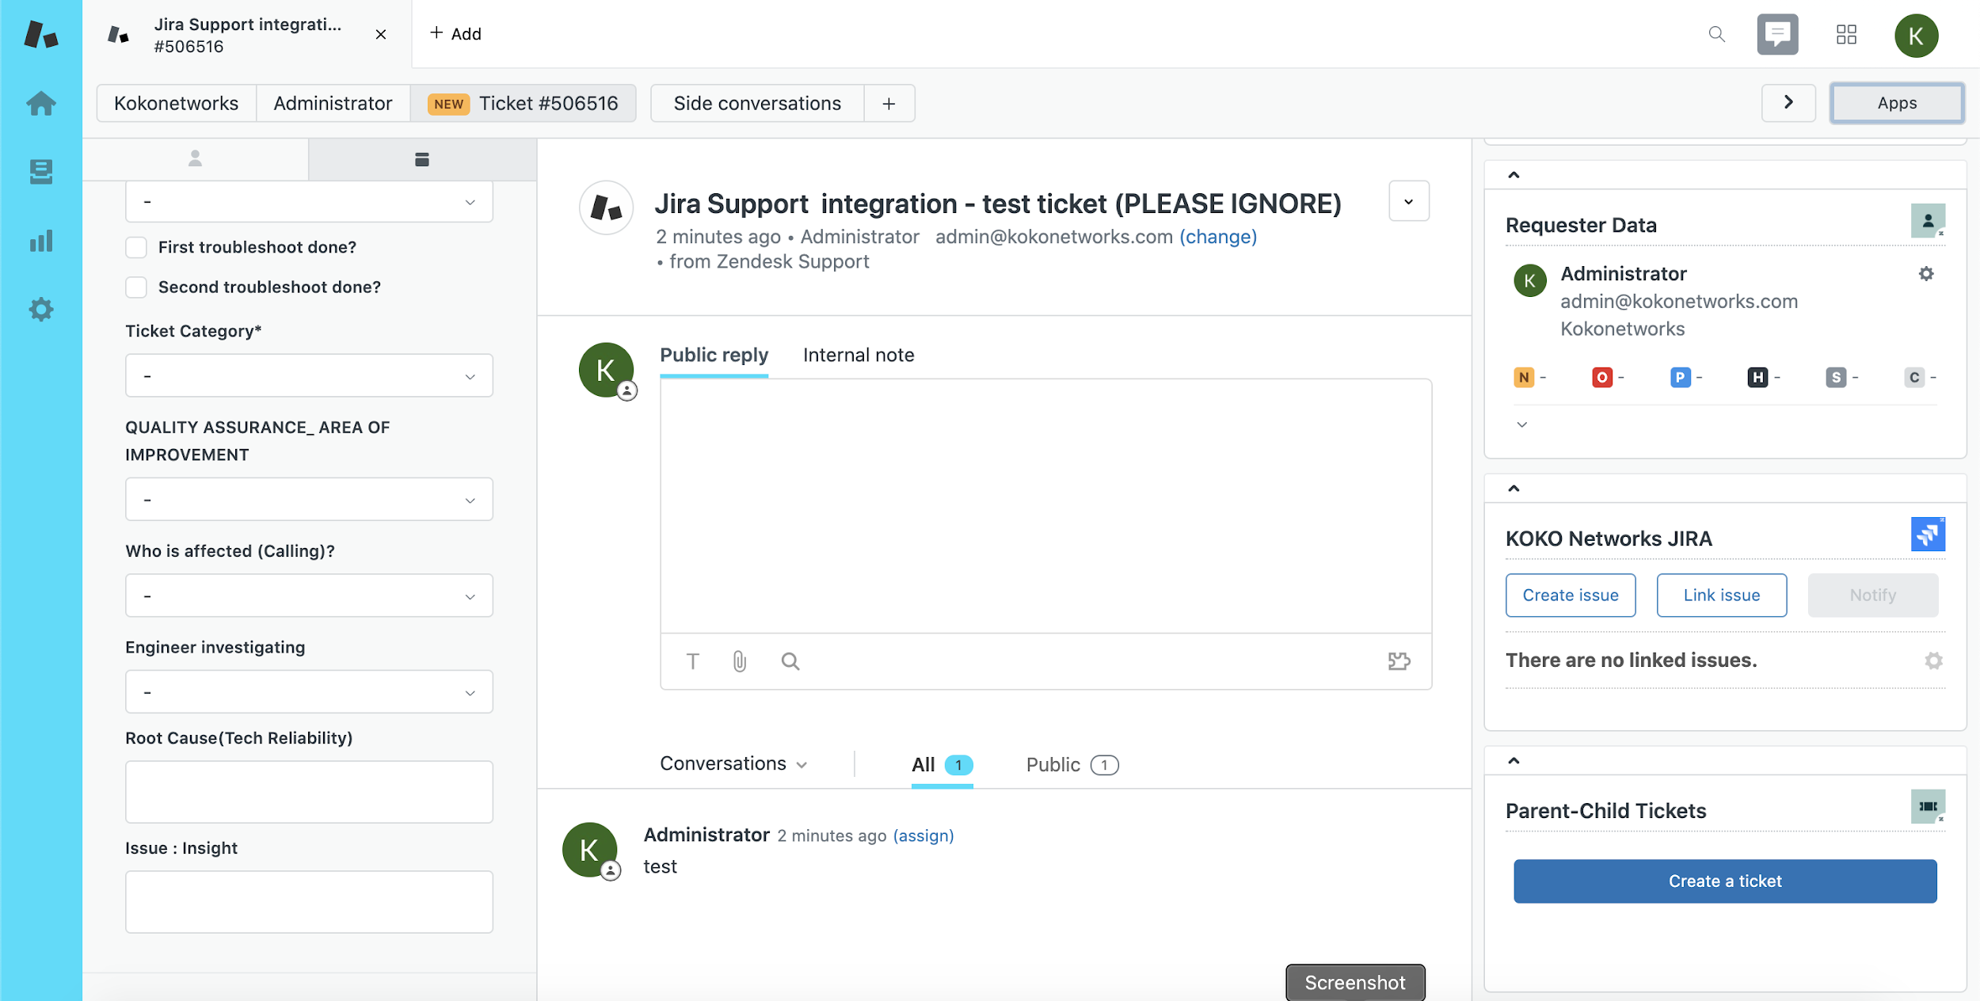
Escalating Zendesk Ticket to Jira Service Management
Open the ticket that requires further investigation and navigate to the right-side menu
Click on the down arrow next to KOKO Networks JIRA on the right-side menu
Click on the Create Issue button

Slide 10
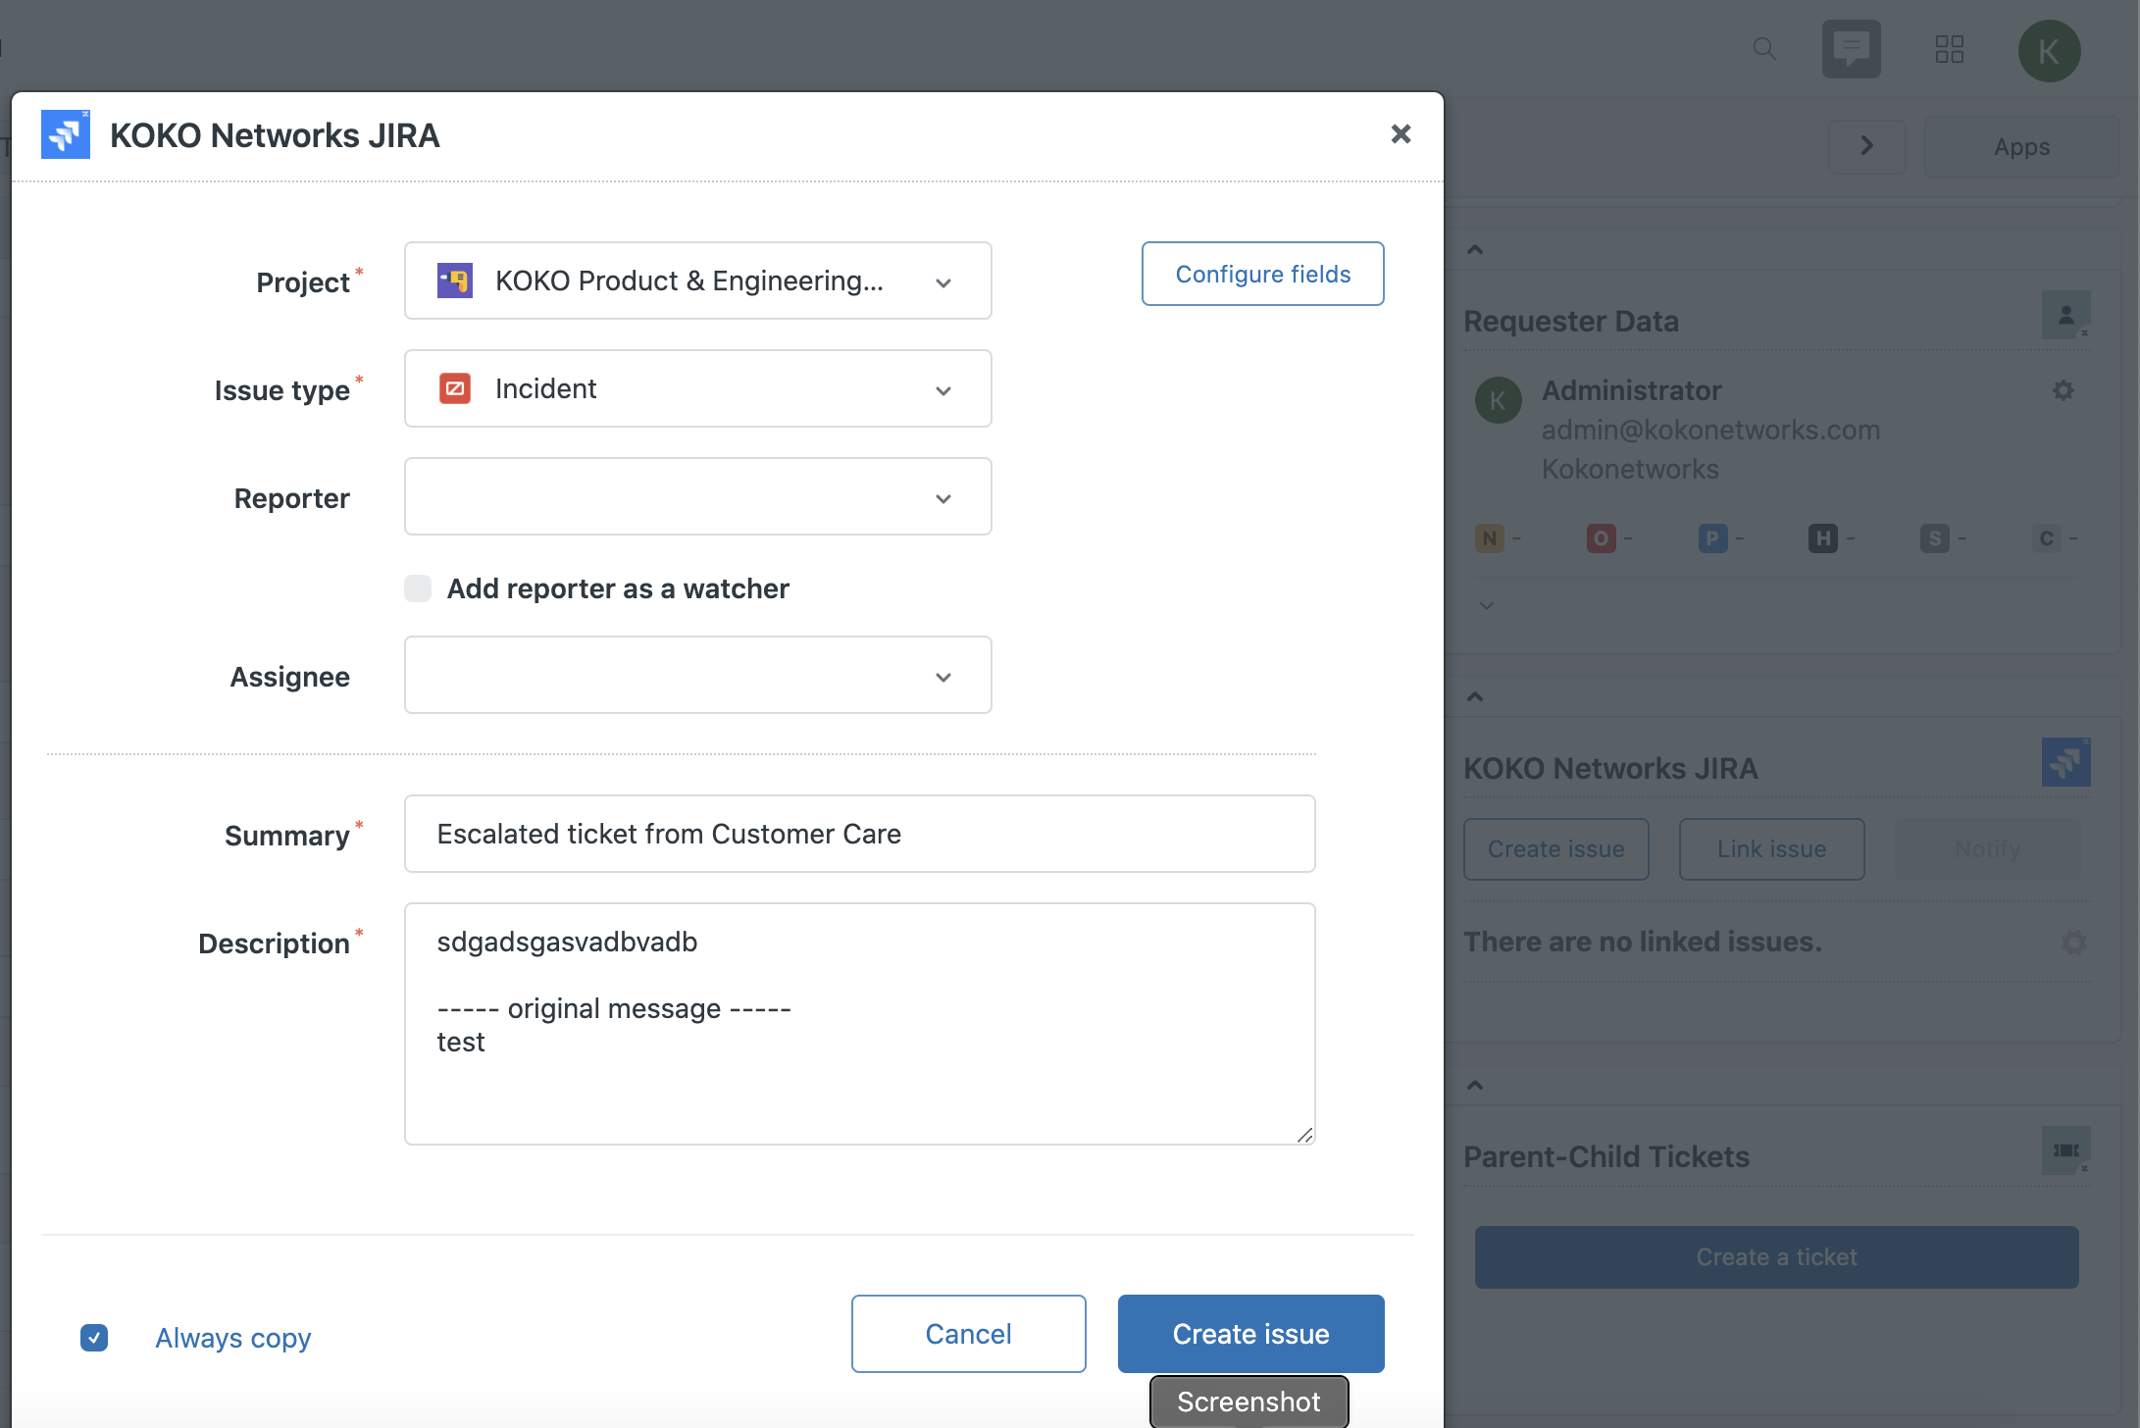
Ticket from Zendesk
Project select “KOKO Product & Engineering Support”
Issue Type must be “Incident”
Ensure the Summary and a Description text box are populated
Click on the “create issue” button
This will create a ticket in Jira Service Management for further investigation

Slide 11
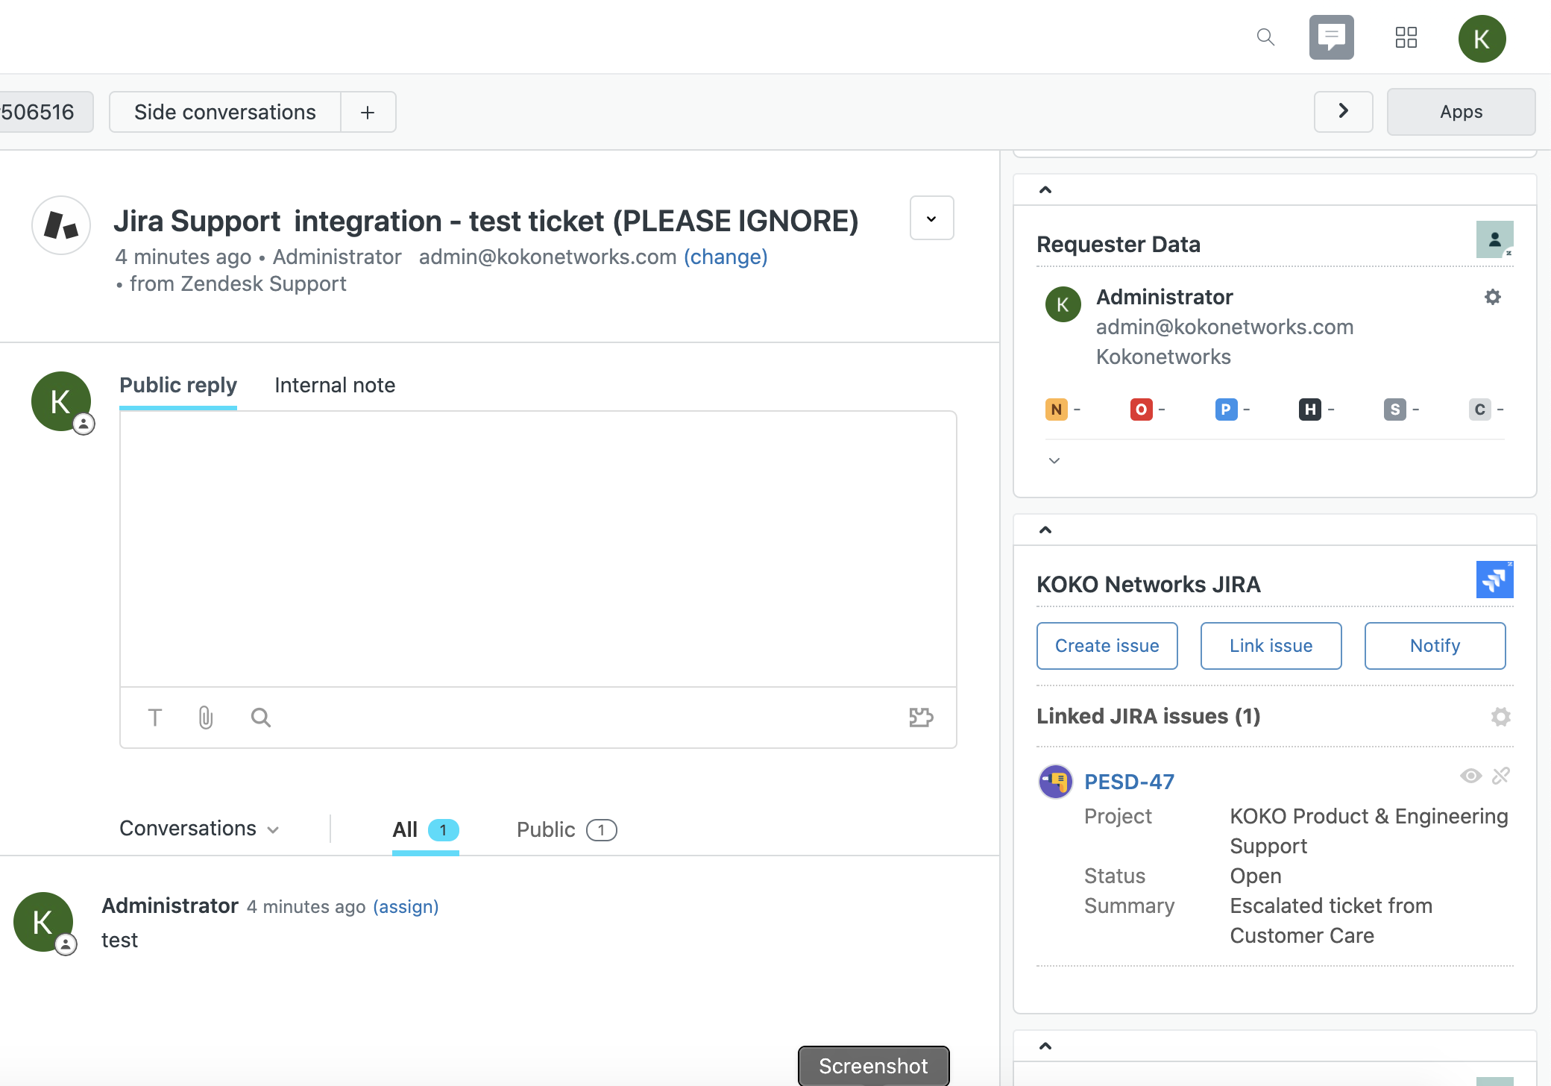
Ticket from Zendesk
Visibility of the Jira ticket on Zendesk

Slide 12
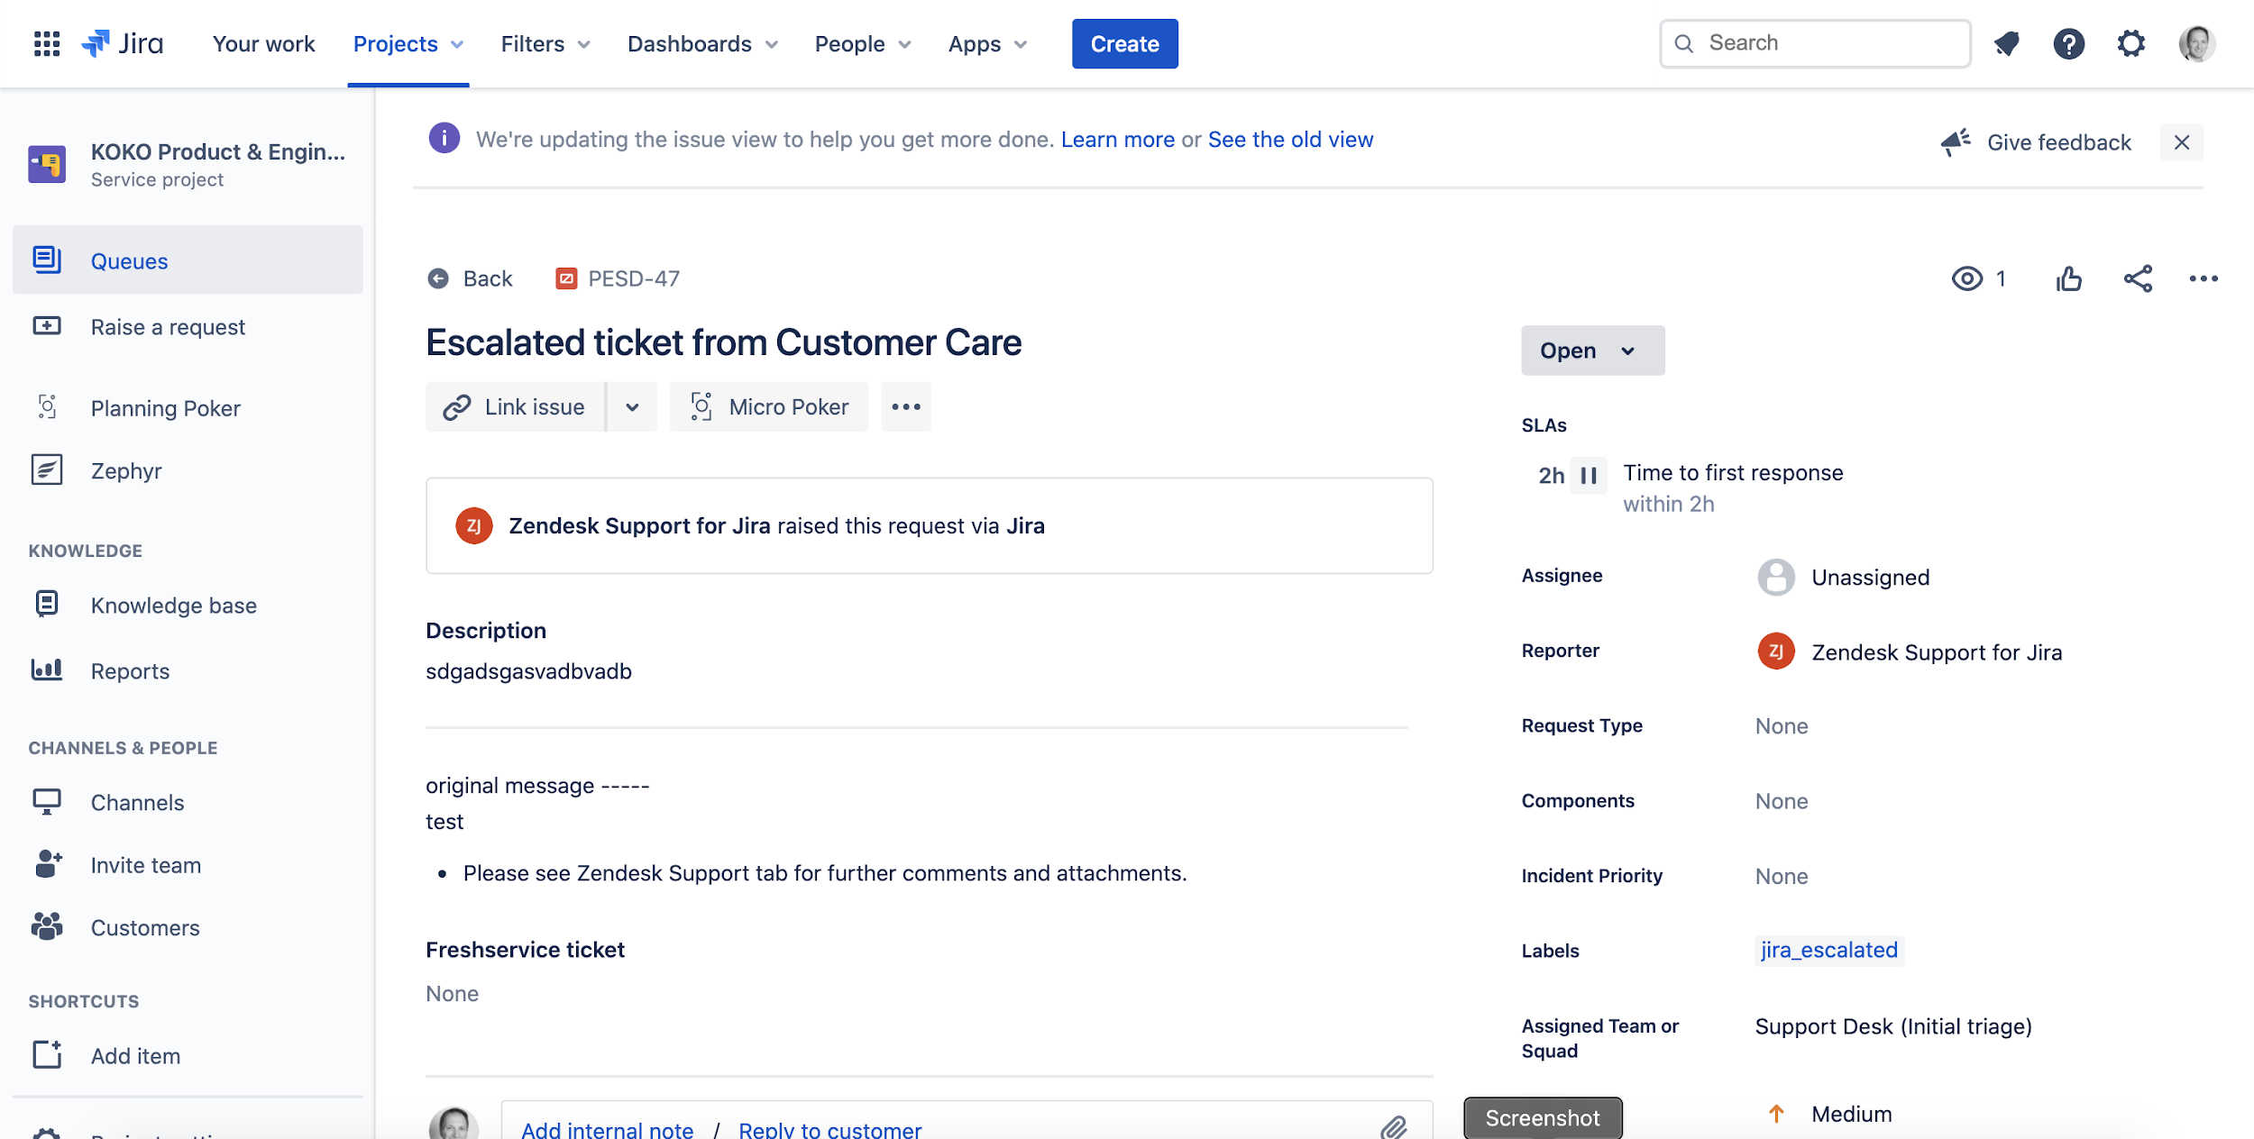
Zendesk Escalated Ticket in Jira Service Desk

Slide 13
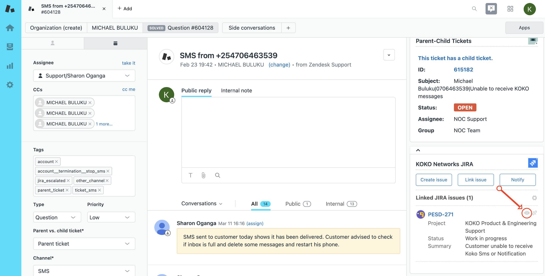
Viewing jira comments/updates on Zendesk
Engineering Team Update: Engineering team will be removing Customer Care users from direct access to Jira.
We shall therefore be required to view Jira comments/updates flow from the view function on zendesk ticket on the eye function as indicated below with an arrow

Slide 14
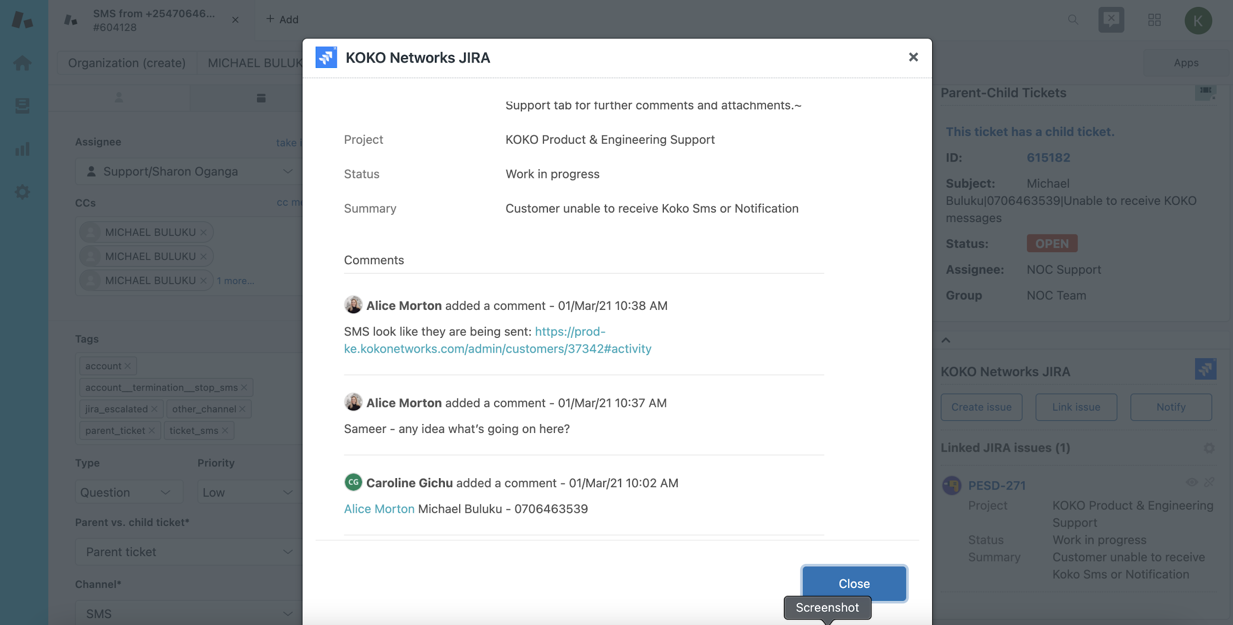
Viewing ticket history/feedback
2. You will see all history in a pop-up like this:
3. This means that the requester from CC must proactively keep checking the eye icon pop up in Zendesk for updates for ticket resolution
4. NO parent ticket should be closed before the escalated child ticket on freshservice/jira is closed.

Slide 15
l.agola@kokonetworks.com

